Slide 1
AWSML Data streaming
ML

Slide 2
Data set resources
https://archive.ics.uci.edu/ml/index.php
https://www.kaggle.com/
https://registry.opendata.aws/
https://cloud.google.com/bigquery/
Load to AWS – s3

Slide 3
Streaming data
Sensors in transportation vehicles
Stock market portfolio adjuster
Real estate website – real time property recommendation
Click stream – likes / dislikes feedback stream
Online gaming – feedback gaming data stream to platform

Slide 4
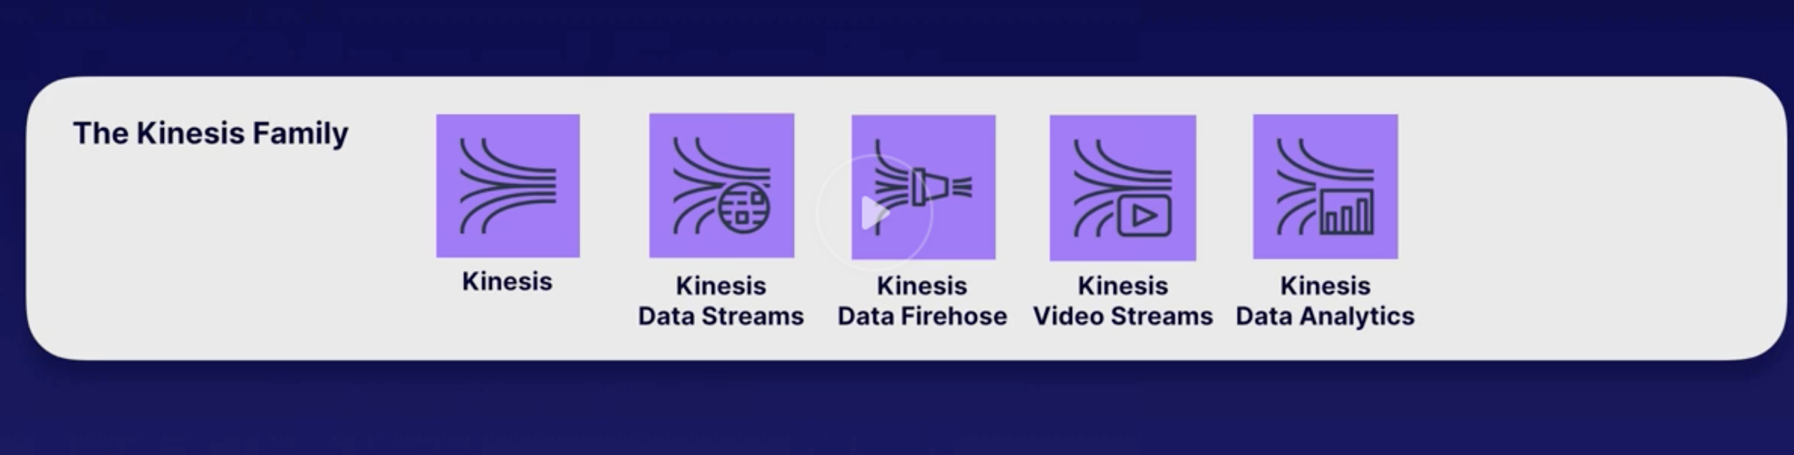
Kinesis

Slide 5
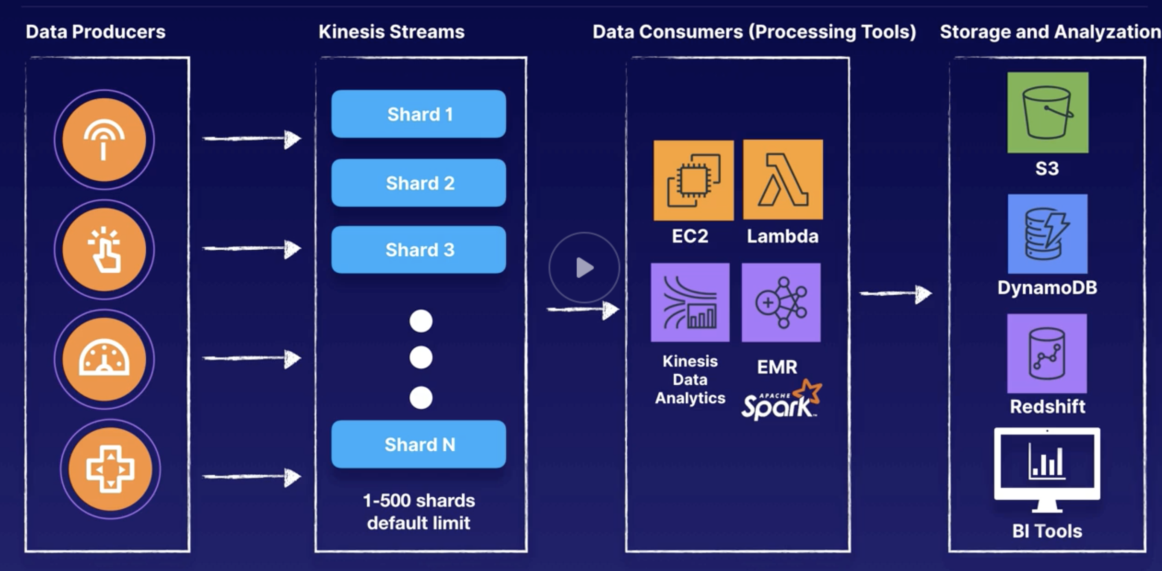
Kinesis Data streams
Shards (1 -500) – containers that hold data to move for processing
Data consumers – process data, sends to data store in AWS

Slide 6
Shards
Partition key is unique for each shard
Sequence is created within shard (ordered)
Data is contained within each sequence
Can be ingested at 1000/records/sec
Default limit – 500 shards – can be requested for increase
Data record
Partition key
Sequence number
Data blob (up to 1MB)
Data stored for 24 hours – 7 days

Slide 7
Libraries
KProcuderLibrary – to write to Kinesis streams
KCL – to consume process data from streams
Kinesis APIs – low level operations to send data to Kinesis streams

Slide 8
Kinesis Firehose
No need of shards; there is no data retention
Can go straight to processing via lambda which again is optional
It can go straight to storage if needed
For DynamoDB you will need it to go through Lambda
When to use?
No need to data retention
Processing is not needed
Needs to go straight to S3
Use cases:
Capture data from IoT and store it in a Datalake
Run ETL jobs before data is stored in datawarehouse

Slide 9
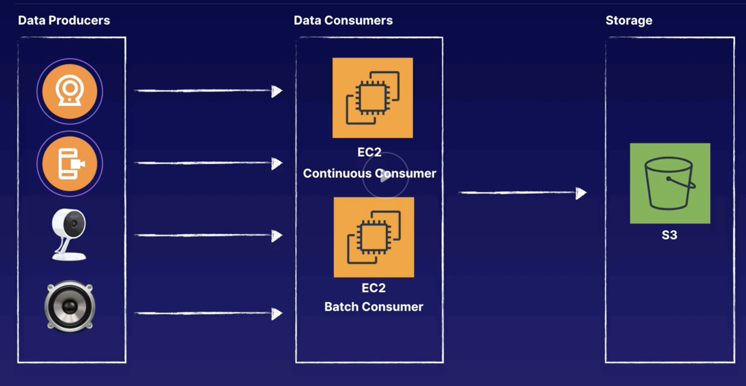
Kinesis Video Streams
Stream live feeds to AWS
Webcams, Security cams, audio feeds, images

Slide 10
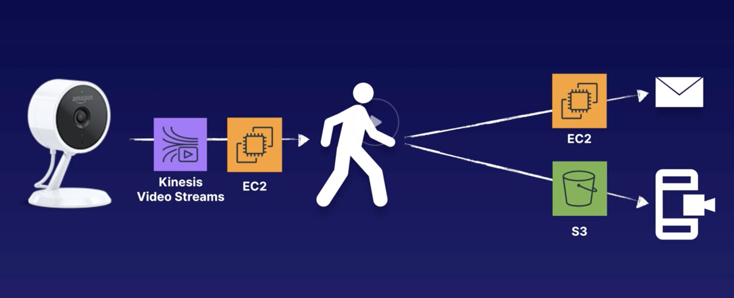
Use case
AWS Cloudcam

Slide 11
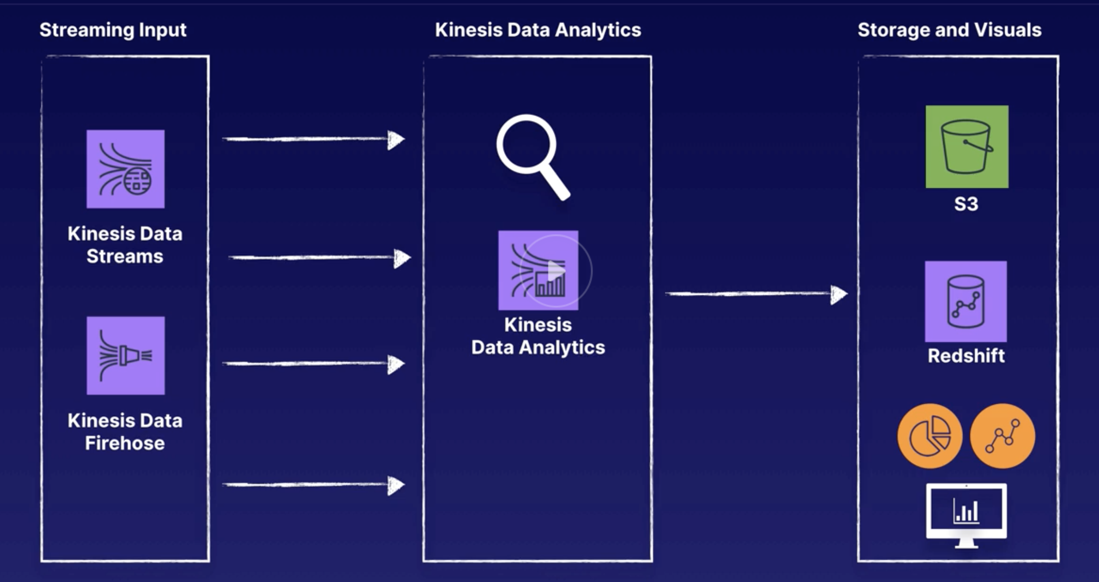
Kinesis Data Analytics

Slide 12
Use case
When we want to run SQL queries on streaming data
We want to output analytic data in S3
We want to create metrics
Real time analytic alerts from streaming data
Stream ETL jobs – clean, enrich, transform raw data and then land in data warehouse or data lake

Slide 13
